Slide 1

Final Project Data Analysis
Is there an association of jobs and demographic data

Slide 2
Cleaning the Data (ETL)
Using Jupyter notebook to clean data from the two sources, Buereau of labor statistics and cubit
Metro_city_data_2020 was used to pull an XLS file into the notebook, clean the data, drop null values and then using SQLAlchemy and psycopg2 to push the data to the postgres database hosted in AWS cloud services

Slide 3
Database
The data is stored in AWS RDS using postgres and contains three tables
Table.bls50metro contains job data from US metro areas from the bureau of labor statistics https://www.bls.gov/oes/tables.htm
Table.democity contains demographic data of all the cities in the jobs table from https://www.cubitplanning.com
Table.jobsdemo contains data for the machine learning algorithm of US metro area jobs and their demographic data.
Bls50metro
Primary Key = Index
Foreign Key = area_title
(Jobs information, total employment, jobs per 1000)
democity
Primary Key = Index
Foreign Key = area_title
(city demographic data, population, race, gender)
jobsdemo
Primary Key = Index
Foreign Key = area_title
(combined city data for jobs and demographic)

Slide 4
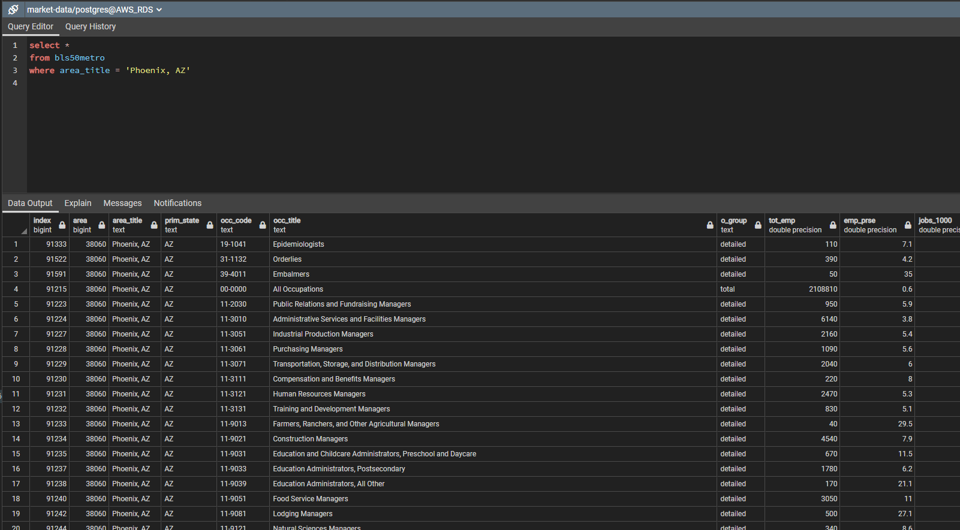
Database

Slide 5
Machine Learning Model

